Slide 1
Game Technology
Lecture 5 – 14.11.2014
Dipl-Inf. Robert Konrad
Dr.-Ing. Florian Mehm

Slide 2
Preliminary timetable
Lecture No. | Date | Topic
1 | 17.10.2014 | Basic Input & Output
2 | 24.10.2014 | Timing & Basic Game Mechanics
3 | 31.10.2014 | Software Rendering 1
4 | 07.11.2014 | Software Rendering 2
5 | 14.11.2014 | Basic Hardware Rendering
6 | 21.11.2014 | Animations
7 | 28.11.2014 | Physically-based Rendering
8 | 05.12.2014 | Physics 1
9 | 12.12.2014 | Physics 2
10 | 19.12.2014 | Scripting
11 | 16.01.2015 | Compression & Streaming
12 | 23.01.2015 | Multiplayer
13 | 30.01.2015 | Audio
14 | 06.02.2015 | Procedural Content Generation
15 | 13.02.2015 | AI

Slide 3
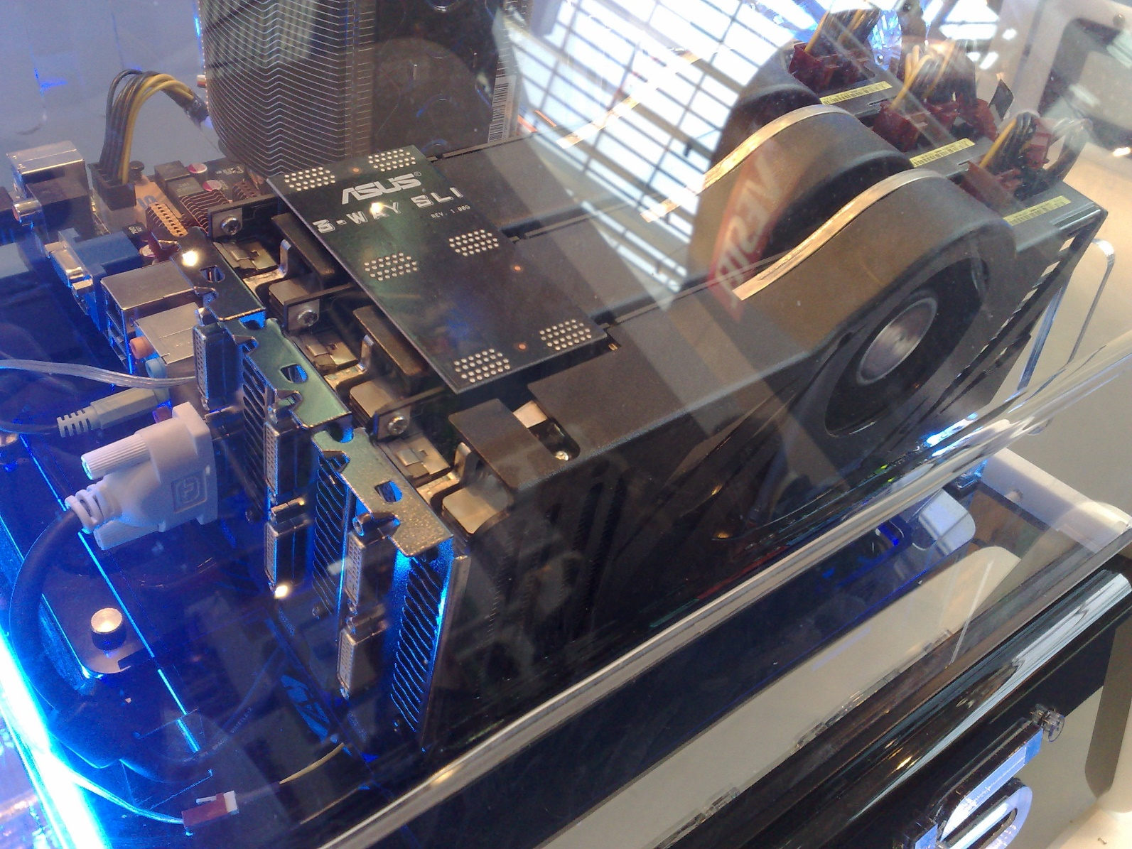
Dedicated Gaming Hardware

Slide 4
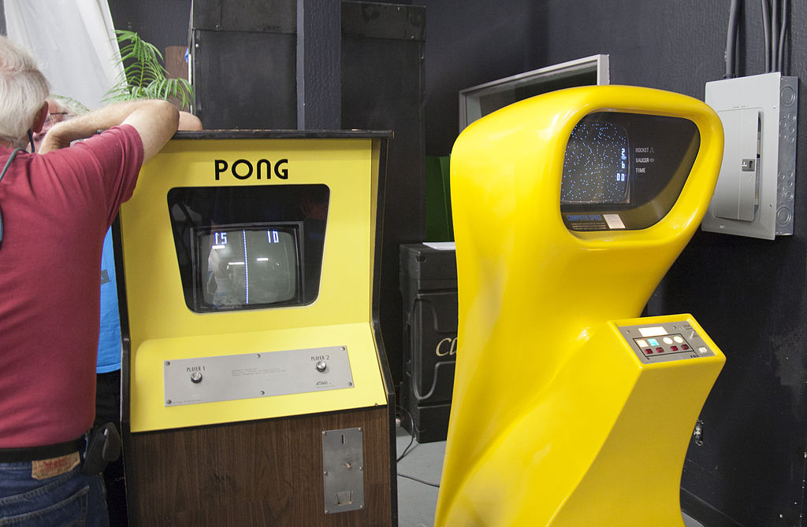
Pong & Computer Space

Slide 5
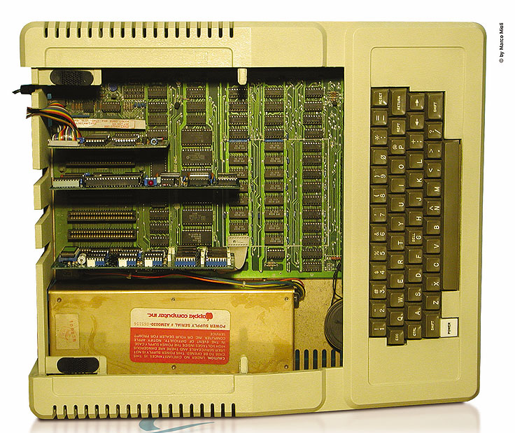
Apple 2

Slide 6
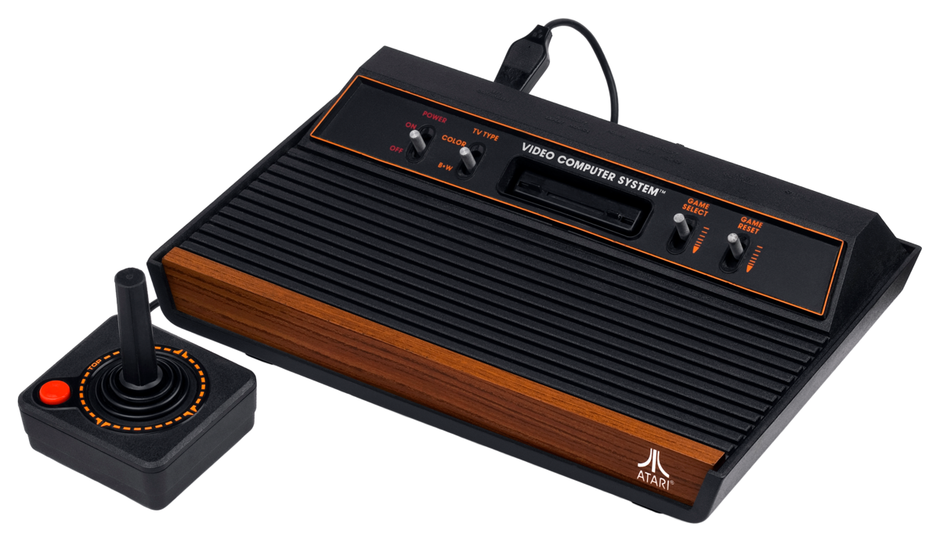
Atari VCS

Slide 7
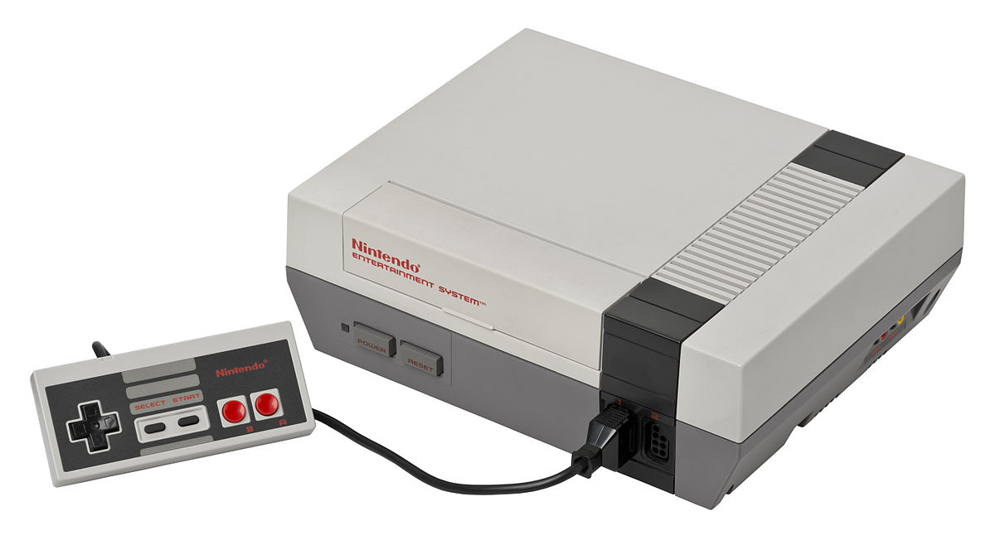
NES

Slide 8
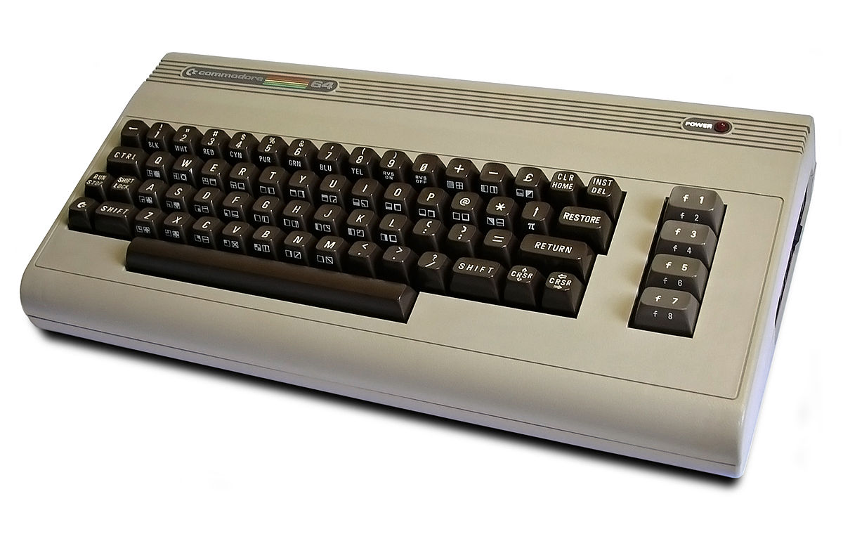
C64

Slide 9
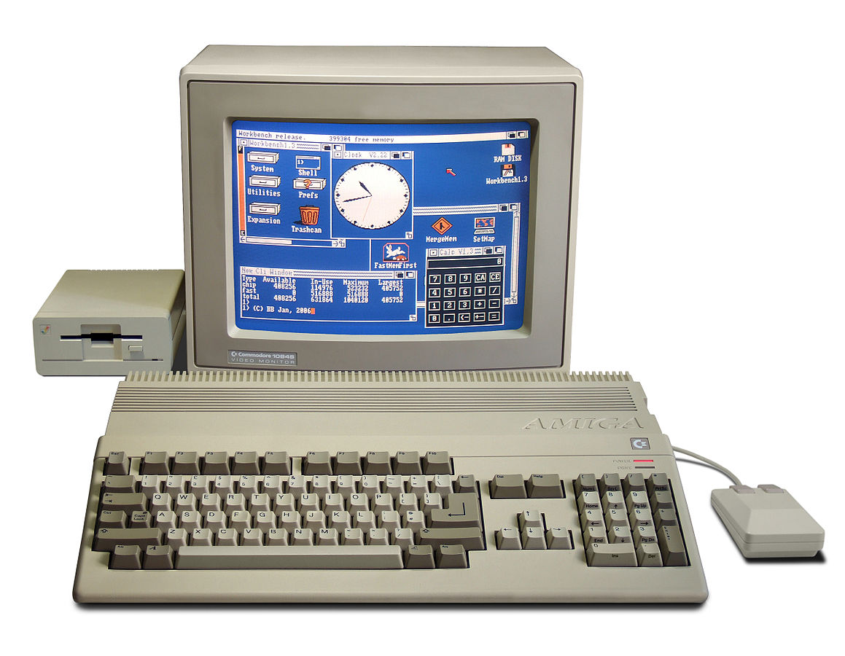
Amiga

Slide 10
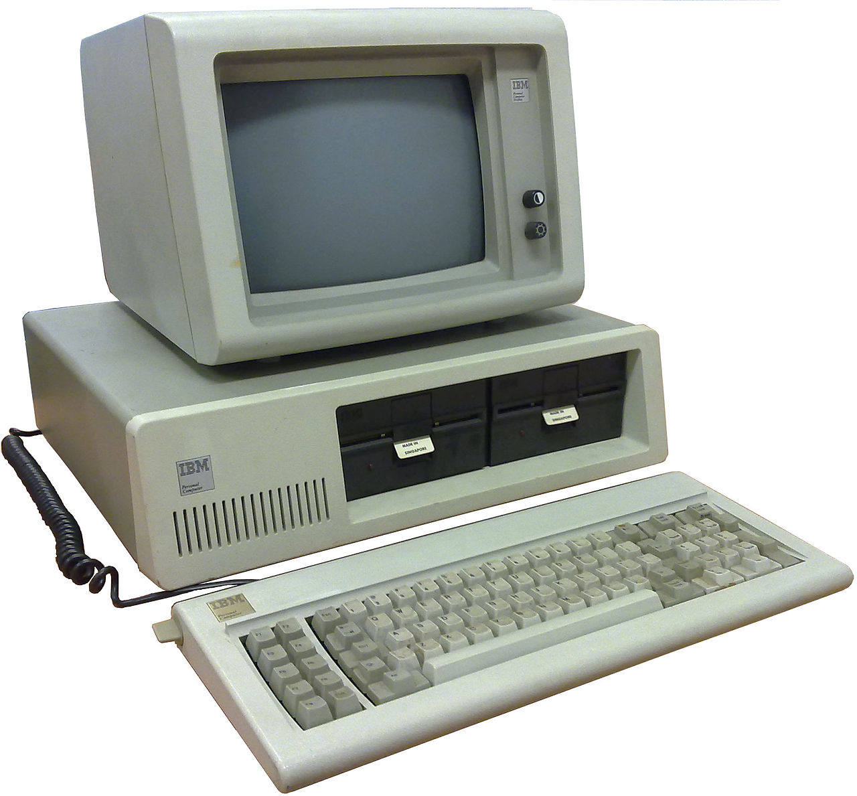
IBM PC

Slide 11
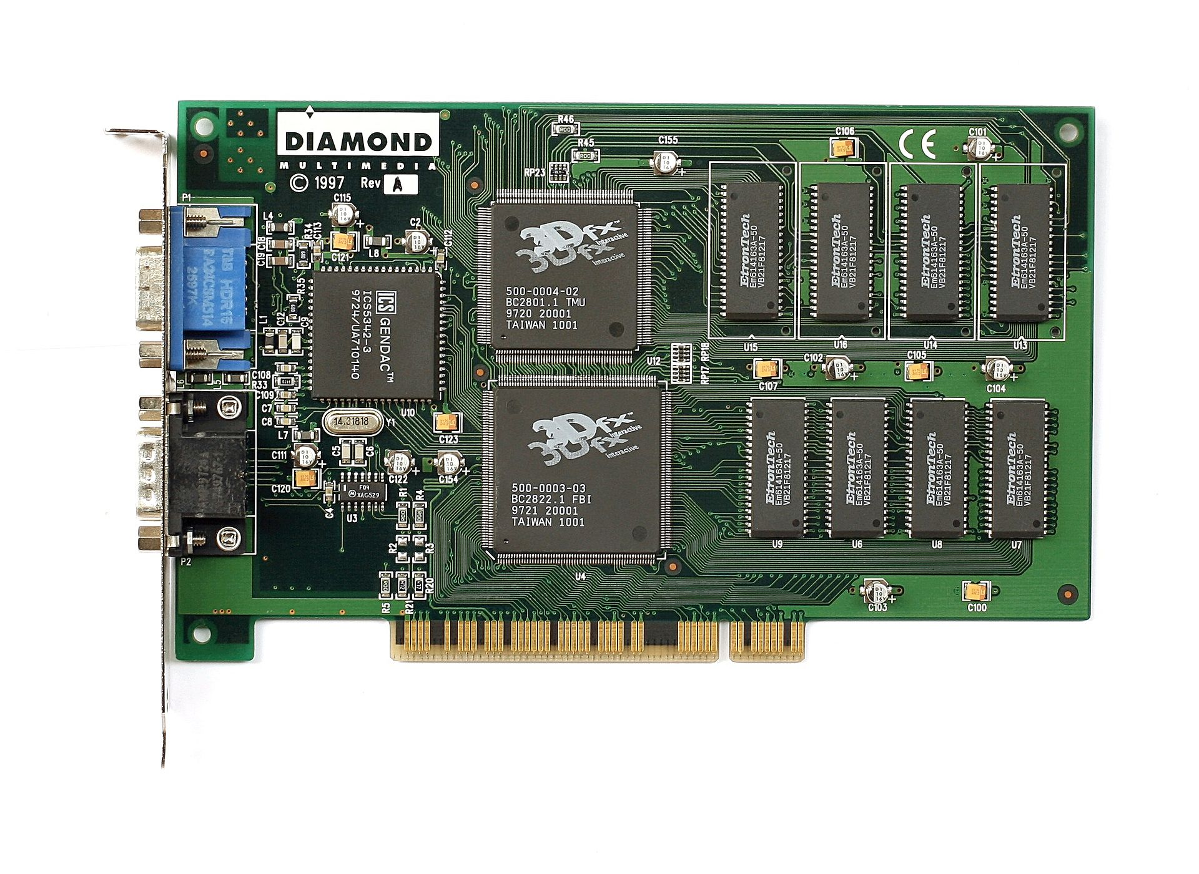
Voodoo

Slide 12
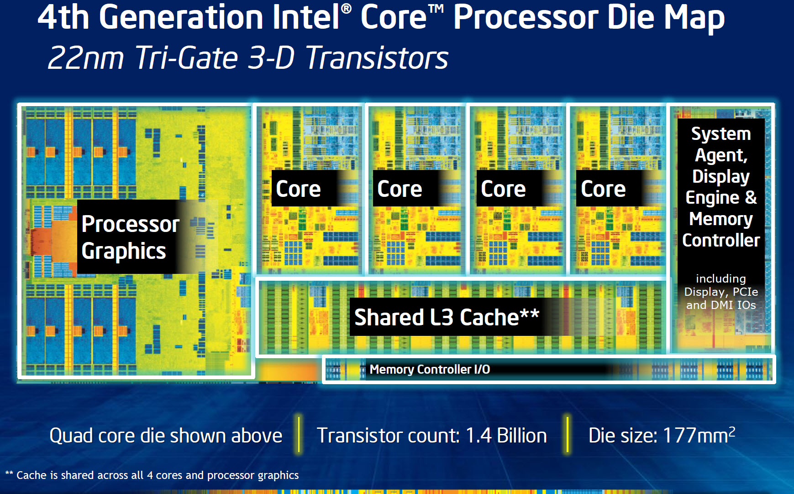
Modern intel CPUs

Slide 13
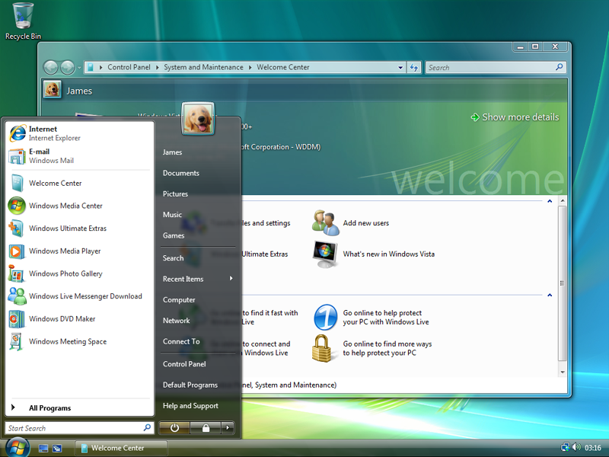
Vista

Slide 14
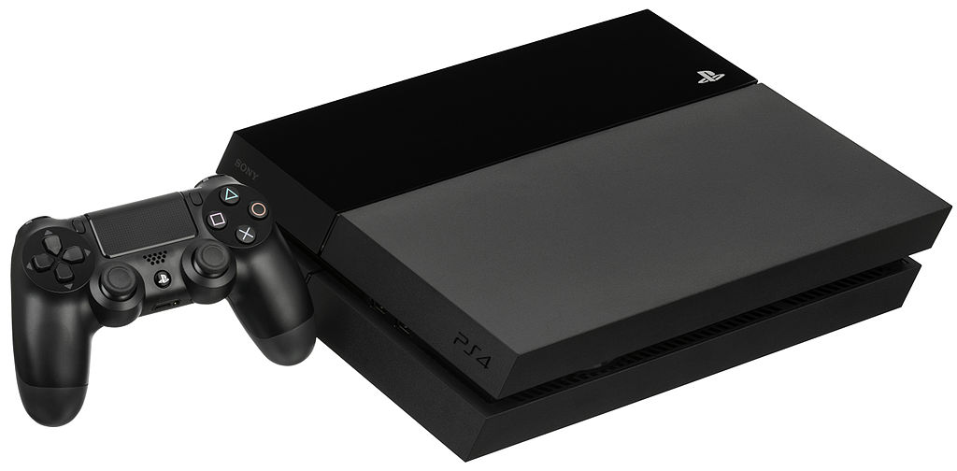
PS4

Slide 15
CPU vs GPU
CPU
Run sequential code as fast as possible
GPU (Graphical Processing Unit)
Massively parallel code execution
Plus triangle rasterizer
Plus texture sampler

Slide 16

Triangles

Slide 17

„Aliasing“

Slide 18
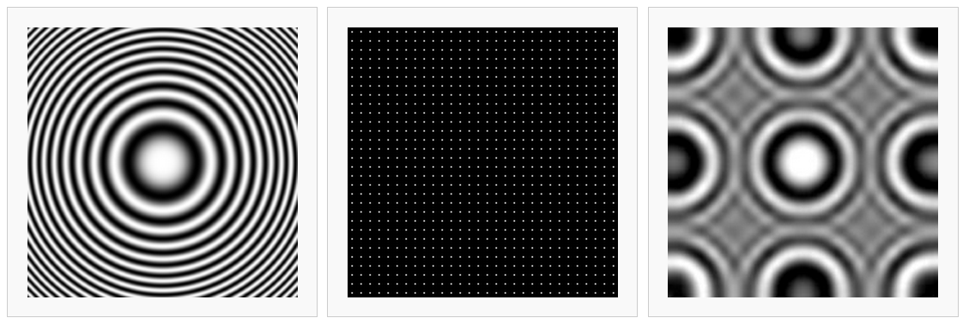
Aliasing

Slide 19

Edge Antialiasing

Slide 20
Supersample Antialiasing

Slide 21
Multisample Antialiasing
Optimized Supersampling
More samples only at triangle edges

Slide 22

Postprocess Antialiasing

Slide 23
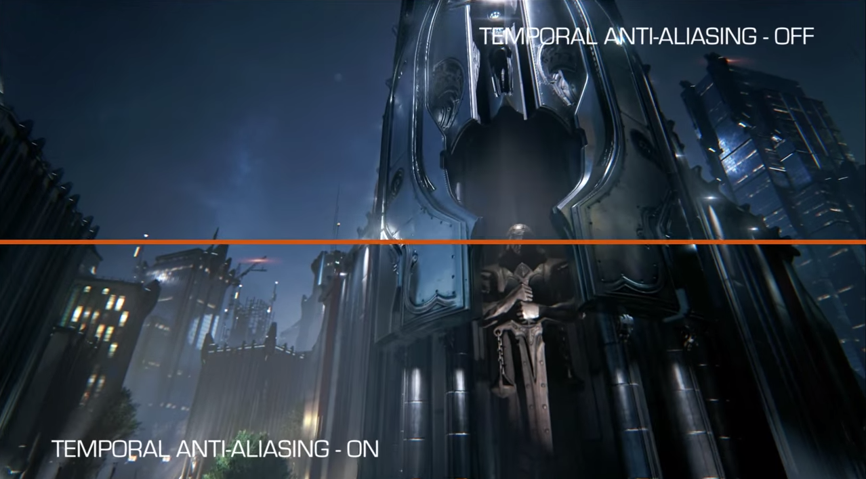
Temporal Anti-Aliasing

Slide 24
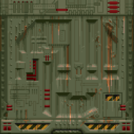
Textures
Basically images
Preferebly 2^n*2^n
Other sizes not necessarily supported
Expand image and fix up texture coordinates

Slide 25
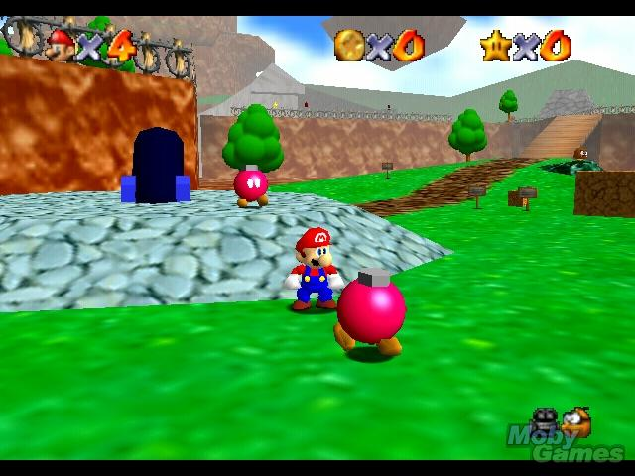
Texture Sampling
Point Filtering
Bilinear Filtering
Interpolate four neighbouring pixels

Slide 26
Mip Mapping
Example: Texture mapped to one pixel
Ideally calculate mean color value of the complete texture
Trick: Precompute images
Width / 2, Height / 2
Width / 4, Height / 4
…
Sample from best fitting image

Slide 27
Mip Mapping
Seams between mip levels are often visible
Trilinear filtering
Perspective stretches images differently in x and y
No optimal mip level

Slide 28
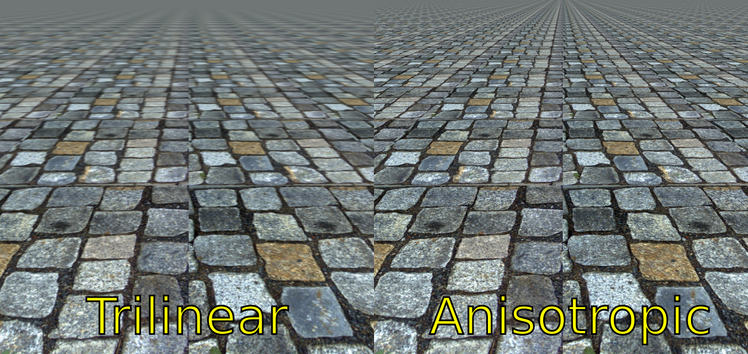
Anisotropic Filtering

Slide 29
Depth Buffer
Implemented in hardware
Used automatically by the rasterizer
3D apis offer simple configuration
Off, allow only smaller values, allow only larger values

Slide 30
Alpha-Blending
Critical for performance
Reads in previous pixels, stresses memory interface
Makes parallel execution more difficult
Fixed modes
1 * new pixel + 0 * old pixel
source alpha * new pixel + (1 - source alpha) * old pixel
…
(destination alpha is rarely used)

Slide 31
Programmable Blending
Render to texture
Draw rendered texture
Draw blended geometry
Use rendered texture as input
Much slower

Slide 32

Most used blending modes
Standard blending
source alpha * new pixel + (1 - source alpha) * old pixel
Additive blending
source alpha * new pixel + old pixel

Slide 33
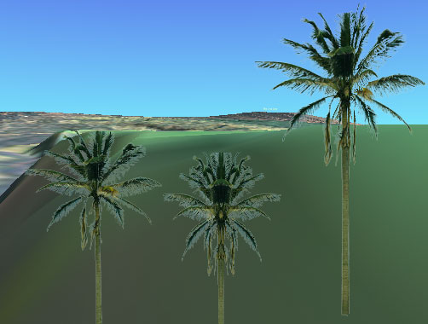
Texture Sampling and Transparency
Bilinear filtering samples rgb + alpha
At alpha borders samples rgb values with alpha 0
Notes:
Image from http://arparso.de/nexus/forum/index.php?topic=76.0

Slide 34
Premultiplied Alpha
Multiply rgb with alpha
Fixes texture sampling (invisible pixels are multiplied with 0)
Fixes sunglasses
Premultiply alpha, then add something
Combines standard and additive blending
Blending mode:
new pixel + (1 - source alpha) * old pixel

Slide 35
Vertex Shader
Calculates vertex transformations
Prepares additional data for later shader stages
See Exercise 3

Slide 36
Fragment Shader
Also called Pixel Shader
Uses interpolated data from vertex shader
Calculates colors
See Exercise 4

Slide 37
Vertex Buffer
Array of vertices
Can hold additional data per vertex
Has to assign additional data to names or registers for vertex shader
Primary interface from CPU to GPU

Slide 38
Index Buffer
Array of indices
That‘s it

Slide 39
Draw Calls
Set Vertex Shader
Set Fragment Shader
Set IndexBuffer
Set Vertex Buffer
DrawIndexedTriangles()
DrawIndexedTriangles()
…

Slide 40
Implicit Work
Create command buffers
Verify data
(compile shaders)
…

Slide 41
Compute Shader
No Rasterization
Additional options for data synchronization
Not yet supported everywhere
Many competing languages
Even OpenCL and GLSL compute shaders

Slide 42
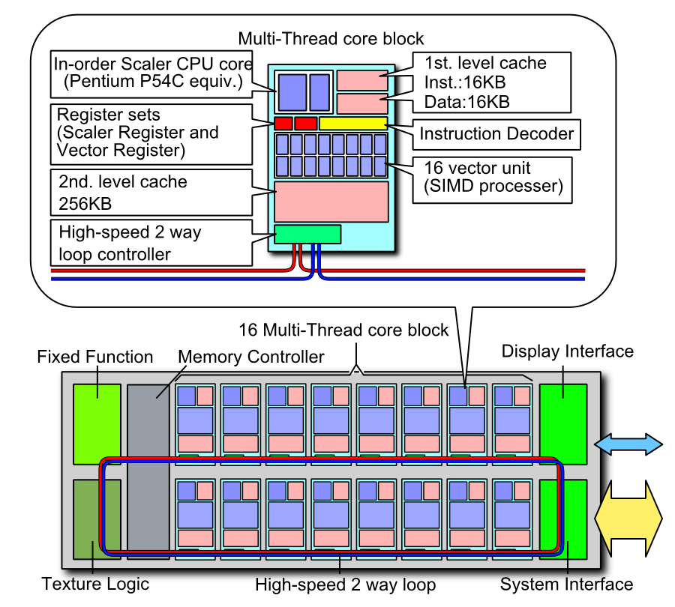
Triangles on Compute
Xeon Phi
Ex project Larrabee
https://code.google.com/p/cudaraster/
From nVidia

Slide 43
More Shaders
Geometry Shader
Works on complete triangles
Tesselation Shader
Can create new triangles
Not yet supported on all hardware
Notably no support on iOS

Slide 44
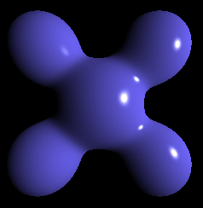
Phong Lighting
color = ambient + diffuse + specular
Note: Light from different sources can always be added just like that

Slide 45

Ambient
Notes:
From http://www.xity.de/nachrichten/graues_herbstwetter_am_wochenende_id2393125.html

Slide 46
Ambient
ambient = constant

Slide 47
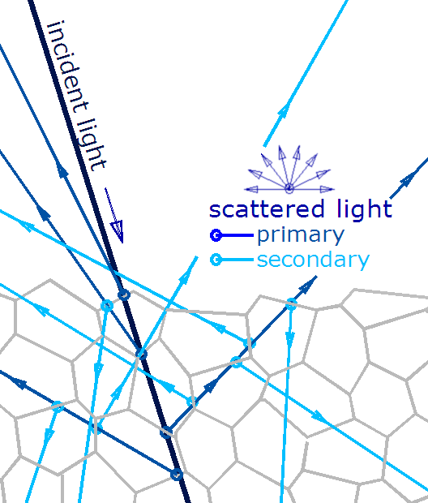
Diffuse

Slide 48
Diffuse
diffuse = LN (see previous lecture)

Slide 49
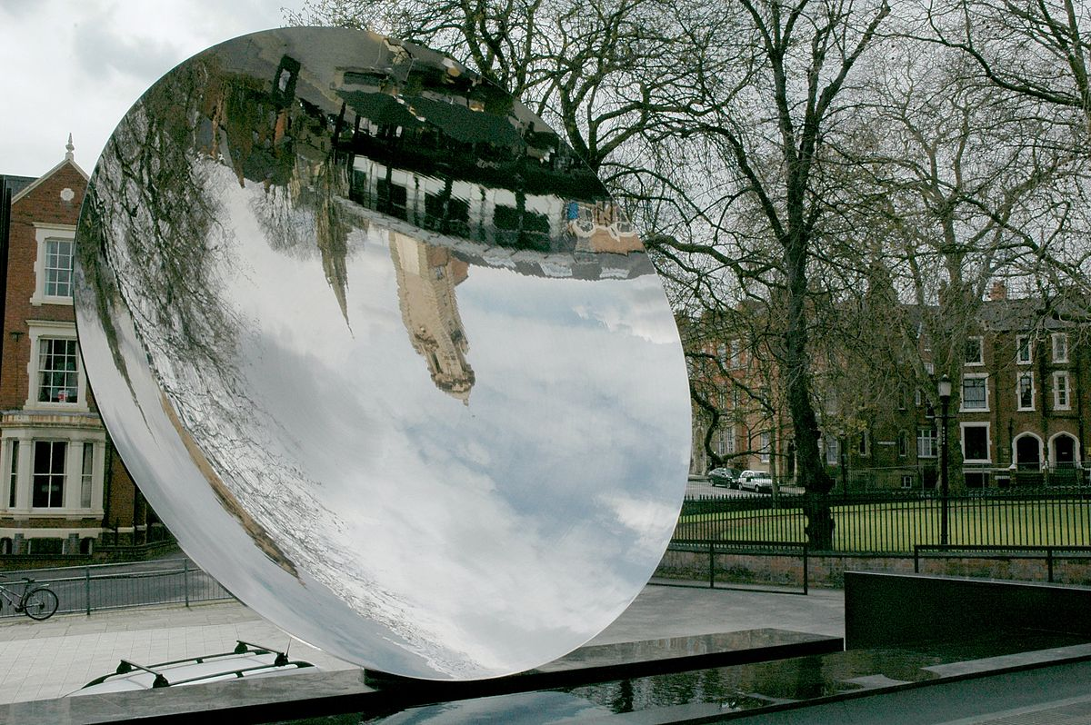
Specular

Slide 50
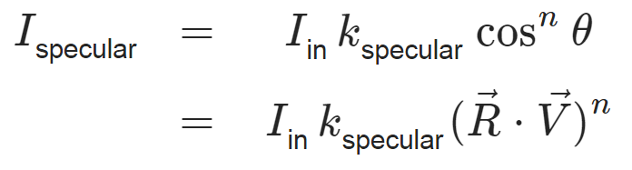
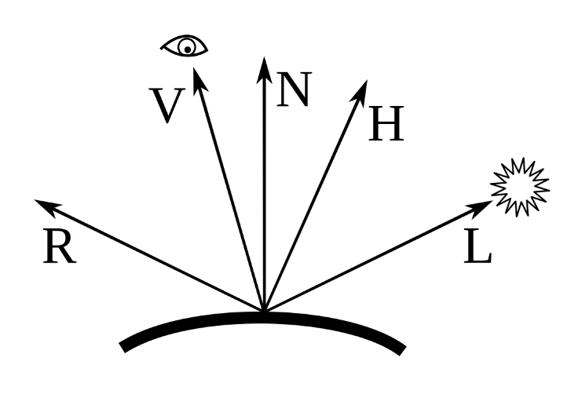
Specular
R: mirrored vector to the light source (reflectance vector)
V: vector to the camera
n: roughness – start at 32 and tune
Empirical model (aka basically nonsense)
Ugly for larger angles (cos -> 0)

Slide 51
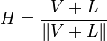
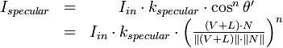

Blinn Phong
A little faster
A little nicer

Slide 52
Better ambient light
Real ambient light is hard
Light bouncing and bouncing and bouncing…
Ambient light tends to look very diffuse
No hard borders
Precompute everything
Put it in small textures
Bilinear filtering blurry stuff works wonderfully

Slide 53
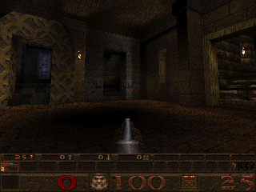
Light Baking

Slide 54
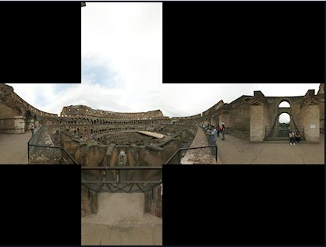
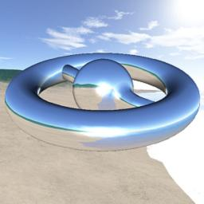
Better specular lighting
Render six orthogonal perspectives into a cube map
Camera center = center of object to be rendered
Sample vector into cubemap for every pixel
Obviously very expensive
Can not be precomputed

Slide 55
Ambient, Diffuse…
Thinking of „Ambient“ is only an approximation
Phong lighting is an approximation of an approximation
Light bounces around
First bounce -> direct lighting (use diffuse and specular)
Second bounce -> hard shadows
More bounces -> ambient light

Slide 56
Shadow Mapping
Set camera to light source
Render depth -> each pixel value = distance from light
During regular rendering
Transform vertices two times
Using camera position
Using light position -> z = distance from light
Read depth texture
Compare depth calculated using light pos and depth from texture
If greater -> in shadow

Slide 57
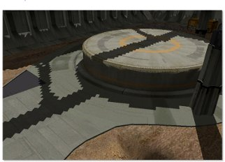
Shadow Mapping
Notes:
http://msdn.microsoft.com/en-us/library/ee416324%28v=vs.85%29.aspx

Slide 58
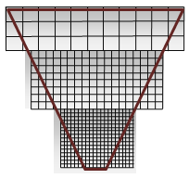
Cascaded Shadow Maps
Notes:
Image from http://msdn.microsoft.com/en-us/library/windows/desktop/ee416307(v=vs.85).aspx

Slide 59
GLSL
Similar to C
Semiautomatic parallelization

Slide 60
GLSL Example
uniform sampler2D tex;
varying vec2 texCoord;
varying vec4 color;
void kore() {
vec4 texcolor = texture2D(tex, texCoord) * color;
texcolor.rgb *= color.a;
gl_FragColor = texcolor;
}

Slide 61
Vertex Shader
Tansforms vertices
Writes transformed vertex to special var
gl_Position
Can write additional data

Slide 62
Fragment Shader
Writes final color to special var
gl_FragColor
Can not write additional data
Mostly (multi target rendering, gl_FragDepth,… - not on all hardware)

Slide 63
Parallelism
Vertex shader defines one function
which is applied to lots of vertices in parallel
Fragment shader defines one function
which is applied to lots of pixels in parallel
Programming model allows hardware to parallelize automatically
To multiple compute cores, SIMD units or weird combinations of both

Slide 64
Uniforms
Constants
Do not change while shader executes
Can be changed between draw calls
uniform mat4 projectionMatrix;
uniform sampler2D tex;

Slide 65
Attributes
Vertex shader input
Defined in Vertex Buffer
attribute vec3 vertexPosition;
attribute vec2 texPosition;
attribute vec4 vertexColor;

Slide 66
Varyings
Transfer data between shader stages
Vertex shader -> interpolation -> Fragment shader
Output in vertex shader, input in fragment shader
varying vec2 texCoord;

Slide 67
Vector types
vec3 position;
vec4 color;
Support basic arithmetic
Support swizzling
color.bgr
position.xy

Slide 68
Matrix types
mat4 projection;
Supports arithmetic with vectors

Slide 69
Samplers
To read textures
uniform sampler2D tex;
vec4 texcolor = texture2D(tex, texCoord);

Slide 70
Special vars
gl_Position
gl_FragColor
https://www.opengl.org/wiki/Built-in_Variable_(GLSL)
There are many more
(so many actually that they forgot one)

Slide 71
Precision modifiers
precision mediump float;
Precision can be reduced
Often makes sense in the fragment shader
And is often necessary (OpenGL ES)

Slide 72
GLSL versions
Up to version 4.5
Different versions for OpenGL ES
Kore uses „GLSL ES“
GLSL version used by OpenGL ES 2.0 and WebGL
GLSL 1.1 plus some 1.2

Slide 73
GLSL in Kore
main is called kore
Only difference to real GLSL
To make things easier in Windows use
node Kore/make gfx=opengl2
Optionally debug Direct3D later
Deletes your varyings in the fragment shader when they are not used, which breaks shader linkage
Shader compiled automatically in Visual Studio
Not in XCode or Code::Blocks
Optionally directly work with the files in Deployment
Beware: A call to koremake overwrites them

Slide 74
Kore Graphics
#include <Kore/Graphics/Graphics.h>
Straight forward api
Set uniforms ala
ConstantLocation loc = program->getConstantLocation(„bla“);
Graphics::setFloat(loc, 2.0f);
Coordinate system is (-1 to 1, -1 to 1, -1 to 1) like in OpenGL

